Slide 1
LOGIN
SIGN UP
USERNAME
USERNAME
Type your username
Type your username
PASSWORD
PASSWORD
Type your Password
Type your Password
CONFIRM PASSWORD
SUBMIT
Type your Password
SIGN UP BELOW
SIGN UP
CREATE ACCOUNT

Slide 2
LOGIN
SIGN UP
USERNAME
USERNAME
Type your username
Type your username
PASSWORD
PASSWORD
Type your password
Type your password
SUBMIT
CONFIRM PASSWORD
Confirm your password
SIGN UP BELOW
SIGN UP
CREATE ACCOUNT

Slide 3
LOGIN
SIGN UP
USERNAME
USERNAME
Type your username
Type your username
PASSWORD
PASSWORD
Type your password
Type your password
SUBMIT
CONFIRM PASSWORD
Confirm your password
SIGN UP BELOW
SIGN UP
CREATE ACCOUNT

Slide 4
LOGIN
SIGN UP
USERNAME
USERNAME
Type your username
Type your username
PASSWORD
PASSWORD
Type your password
Type your password
SUBMIT
CONFIRM PASSWORD
Confirm your password
SIGN UP BELOW
SIGN UP
CREATE ACCOUNT

Slide 5
LOGIN
SIGN UP
USERNAME
USERNAME
Type your username
Type your username
PASSWORD
PASSWORD
N
N
Type your password
Type your password
SUBMIT
CONFIRM PASSWORD
N
Confirm your password
SIGN UP BELOW
SIGN UP
CREATE ACCOUNT

Slide 6
LOGIN
SIGN UP
USERNAME
USERNAME
Type your username
Type your username
PASSWORD
PASSWORD
N
N
Type your password
Type your password
SUBMIT
CONFIRM PASSWORD
N
Confirm your password
SIGN UP BELOW
SIGN UP
CREATE ACCOUNT

Slide 7
X
LOGIN
SIGN UP
USERNAME
USERNAME
Type your username
Type your username
PASSWORD
PASSWORD
N
N
Type your password
Type your password
SUBMIT
CONFIRM PASSWORD
N
Confirm your password
SIGN UP BELOW
SIGN UP
CREATE ACCOUNT

Slide 8


LOGIN
SIGN UP
USERNAME
USERNAME
Type your username
Type your username
PASSWORD
N
PASSWORD
Type your password
N
Type your password
TYPE USERNAME AND PASSWORD INTO THE TEXT BOXES AND CLICK SUBMIT
CONFIRM
PASSWORD
N
Confirm your password
SUBMIT
CREATE ACCOUNT
NO ACCOUNT?
SIGN UP BELOW
SIGN UP
RETURN

Slide 9
LOGIN
SIGN UP
USERNAME
USERNAME
Type your username
Type your username
PASSWORD
PASSWORD
N
N
Type your password
Type your password
SUBMIT
CONFIRM PASSWORD
N
Confirm your password
SIGN UP BELOW
SIGN UP
CREATE ACCOUNT

Slide 10
HOW TO USE THE VISUALISER
Choose a generation speed:
Slow, Medium or Fast
Click ‘Generate Maze’ to generate a new maze using Prim’s algorithm
Once the Maze has generated, select a solving speed
Slow, Medium or Fast
Select a pathfinder to apply to the maze:
Depth-First Search
Breadth-First Search
A-Star Search
A new pathfinder can be selected after the process has finished
A new maze can be generated at any time
CLOSE

Slide 11
X
MAIN MENU
MAIN MENU
VISUALISE
STATISTICS
PLAY
X
STATISTICS
SIGN OUT
SIGN OUT

Slide 12
X
NEW GAME
NEW GAME
HOW TO PLAY
80X80
20X20
30X30
MAIN MENU
40X40
MAIN MENU

Slide 13
X
LEADERBOARD
LEADERBOARD
20X20
30X30
40X40
MAIN MENU

Slide 14
SOLVED!
SOLVED!
TIME:
MAZE:
00:32:14
TIME:
MAZE:
NEW GAME
40x40
NEW GAME
MAIN MENU

Slide 15
80x80
40x40
USERNAME | TIME
NEW GAME
RETURN
USERNAME
TIME
RETURN

Slide 16
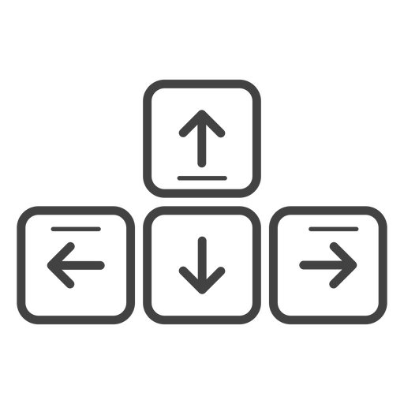
HOW TO PLAY THE MAZE GAME
Use the arrow keys to move through the maze:
Maze choices:
20x20 - Easy
40x40 - Medium
80x80 - Hard
The end square is coloured red, this is your target
You will have 3 seconds before the timer starts and you can play the maze
The fastest scores be added to the leaderboards
Once you have solved the maze, you will have the option to play a new game or return to the main menu
You can return the menu, close the program or start a new game at any time
CLOSE

